Slide 1
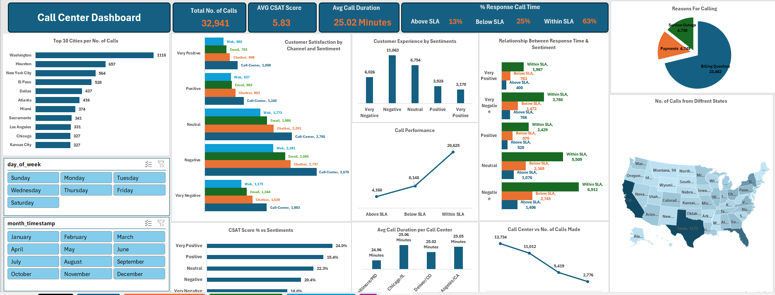
Erick N. Muguro
Data Analysis Portfolio
Call Center Performance Analysis
Date:
06 September 2025.

Slide 2
Problem Statement
A US- Based Call Center network wanted to understand Customer Satisfaction (CSAT), Service Level Agreement(SLA) compliance, and kay drivers of call volumes. Leadership needed insights into which Channels drive satisfaction, how Response Time impacts Sentiments and where to prioritize improvements.
Define Key Question
Customer Experience:
What’s the distribution of Sentiment (Positive, Neural, Negative)?
How does CSAT Score vary across Sentiment categories?
Which Channels (Call-Centre, Chatbot, Email, Web) drive the best customer satisfactions?
Performance:
How often do calls fall Within SLA vs Above/ Below SLA?
What is the average Call Duration per Call Center location?
Which States or Cities have the most calls?
Operations:
What is the most common Reasons for Calls(Billing Questions, Payments, Service Outage)?
Which Call Center hander the highest volume and how does performance differ?
Is there a relationship between response time and customer sentiment?

Slide 3
Key Performance Indicators at a Glance
32,941
Total Calls
The Call Centre handled a total of 32,941 calls, showing a high interaction volume across multiple states.
KPIs Summary
5.83
(out of 10)
The average CSAT Score is 5.83/10, indicating room for improvement in customer satisfaction
Average CSAT Score
25
Minutes
Average Call Duration
Average Call Duration is 25 minutes, suggesting calls are relatively lengthy and may affect efficiency

Slide 4
Key Performance Indicators at a Glance: SLA Compliance
63%
Within
SLA
KPIs Summary
63% of calls were resolved Within SLA, while 25% fell Below SLA and 13% Above SLA.
This highlights the need to improve response consistency and reduce delays
25%
Below
SLA
13%
Above
SLA

Slide 5
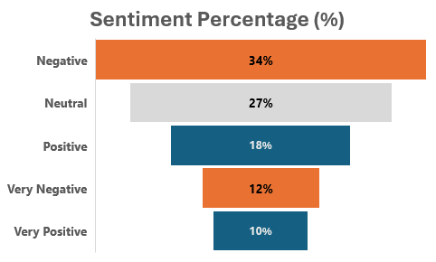
Key Performance Indicators at a Glance: Sentiment
KPIs Summary
Over Half of customers (52%) reported Negative or Very Negative experiences, showing major service quality concerns.
Only 22% of customers had Positive or Very Positive experiences, highlighting the need to strengthen customer engagement
The 27% neutral group represents an opportunity by improving service consistency, many can shift towards positive sentiment

